Slide 1
Help! How do I support struggling readers?
An introduction to accessible literacy and reading formats.

Slide 2

Land acknowledgement
I live and work in Toronto, the traditional territory of many nations including the Mississaugas of the Credit, the Anishnabeg, the Chippewa, the Haudenosaunee and the Wendat peoples. This territory is now home to many diverse First Nations, Inuit and Métis peoples. This land is covered by Treaty 13 with the Mississaugas of the Credit.
Wherever we find ourselves today, across Turtle Island, we can be grateful to the First Nations for their careful stewardship of the land.

Slide 3
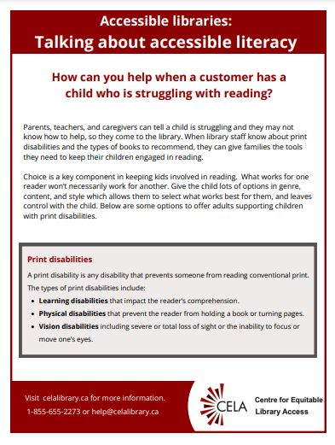
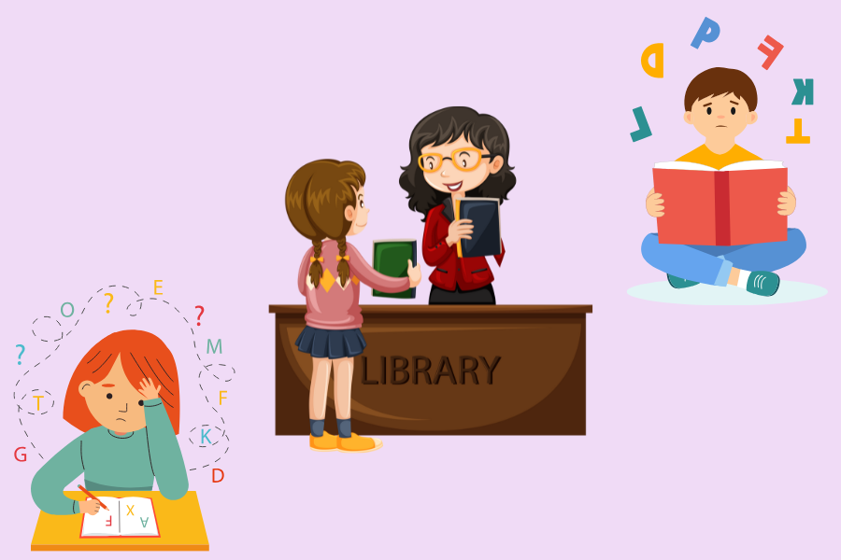
How can you help someone who is struggling to read?
Notes:
This webinar is the result of a new series of resource documents CELA is creating regarding accessible library services. The first in our “Accessible libraries” series is “Talking about accessible literacy” which highlights the many different reading formats that any reader can use to help develop their reading skills, which will hopefully lead to an enjoyment of reading.
While the document was written for a library staff audience to answer the question “How to help when a struggling reader comes to the desk?”, we knew that the knowledge about accessible formats goes beyond a library environment, and can apply to parents, teachers or anyone wishing to learn more.

Slide 4
Learning goals
Review the different types of print disabilities and their unique reading needs.
Discover various reading formats and their accessibility features.
Learn how alternate formats contribute to literacy development.
Learn helpful tips for supporting struggling readers, including those with print disabilities.
Notes:
Today you’ll learn about the different types of print disabilities and their unique reading needs. We’ll then describe how the accessibility features offered in different reading formats support the various reading needs and how they contribute to literacy development. We’ll end the presentation by giving you some practical tips so you can support readers.
To begin our presentation, we’re going to ask you to participate in a poll. Please tell us if you’ve used any of the following accessible reading formats recently.
“Select any reading formats you’ve used recently.”
Options: audiobook, e-book, braille book, any other print formats: large print, comic book, graphic novel, I haven’t used any of these formats recently.
Launch POLL

Slide 5
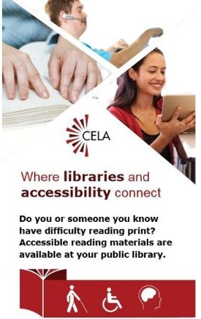
What is CELA?
Is a free library service offered through Canadian public libraries
Serves people with print disabilities across Canada
Provides materials in accessible formats, like braille, e-text and audio
Notes:
CELA is a comprehensive accessible library service, providing over 1,000,000 books, magazines and newspapers to people with print disabilities living in Canada. CELA is a national not-for-profit organization that provides accessible reading services to the approximately 3 million people across Canada with print disabilities. Our services ensure that people with print disabilities across the country are more able to fully participate in learning, work and community life and contribute to the social, cultural, and economic development and success of their local and broader communities.
Our mission is to support public libraries in the provision of accessible library collections and to champion the fundamental right of Canadians with print disabilities to access media and reading materials in the format of their choice.
Our collection includes books for all ages in English and French. We also offer another collection called Bookshare which is a US online library of accessible formats. While registering for CELA does not require any medical validation of their disability, patrons and educators with library cards from CELA member libraries would have to fiil in a Proof of Disability form to access Bookshare titles.

Slide 6
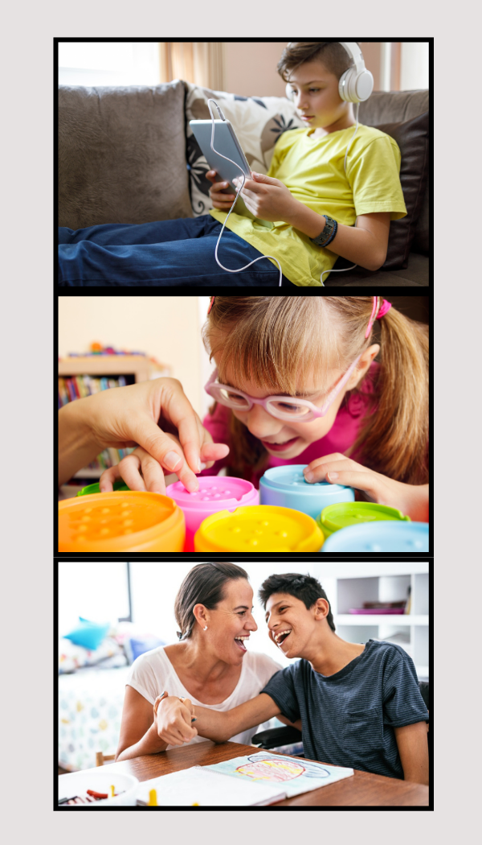
Print disabilities
Learning
Mobility
Vision
Notes:
The definition of “print disability” comes from the Copyright Act of Canada that allows an organization like ours, to produce print materials in accessible formats for people with print disabilities. A print disability is a disability that prevents or inhibits a person from reading a literary, musical, dramatic or artistic work in its original format. The three types of print disabilities include a learning disability like dyslexia, a physical disability where the person cannot hold or turn the pages of a book, or a severe visual disability.
To register for CELA, you can fill out our online registration form which asks you for your public library card number. You can also register at public libraries that are CELA Member Libraries. In BC, most public libraries offer access to CELA’s physical and digital collections, but if your library is not a member, you may only download our audio, e-text and braille books. On our registration form, we ask that the person self-declare that they have a print disability and do not ask for any proof of disability. We take this approach so the person with a print disability can access the reading materials they need in the format of their choice. Educators and other professionals with library cards from CELA Member Libraries can also get their own CELA account to support their students and clients.

Slide 7
Reading difficulties
Struggling
Difficulty reading
Affects fluency, comprehension, etc.
Reluctant
Reading avoidance
Doesn’t like to read
Print disabilities
Learning, visual or physical
Requires alternate formats
Notes:
We thought it would be helpful to define the term “struggling” reader and “reluctant” reader and how print disabilities fits into this context. A struggling reader is a broad term to describe someone who has difficulty reading which may involve experiencing challenges with one or more concepts such as fluency, vocabulary, comprehension and writing. For the purposes of our presentation, we’ll use struggling readers to describe any reader who faces difficulties reading written text.
The next term, “reluctant reader” simply refers to a reader who doesn’t like to read and tends to avoid it. Of course, there is a strong link between struggling readers and reluctant readers since readers may not wish to read if it’s something they find is very hard to do.
The other factor that can lead to reading difficulties and reluctance is a print disability. The combination of these three factors can contribute to reading struggles which may lead to lack of self-esteem and confidence and may affect their overall education. However, according to the International Literacy Association, kids can improve their reading skills with the right kind of instruction and classroom experience. We believe that using the right kind of accessible formats, often designed for print-disabled readers will also support learning to read.
Sources: https://accessiblereading.com/what-is-a-print-disability/
https://www.literacyworldwide.org/get-resources/resources-by-topic/struggling-readers
https://www.literacyworldwide.org/docs/default-source/where-we-stand/ila-children-experiencing-reading-difficulties.pdf?sfvrsn=eff5bf8e_6

Slide 8
Print material accessibility in Canada
Print material accessibility in Canada in 2023.
5.2 million indicated they had a difficulty with print material
Over 35% use at least alternate format
Younger participants more likely to ask for alternate format materials.
Notes:
In 2023, Statistics Canada published the “Print material accessibility in Canada” study. They learned that 5.2 million Canadians indicated they had difficulty reading print materials and 35% use alternate formats. The minimum age of the participants was 15 years old and the younger participants indicated they were more likely than older ones to ask for reading materials in accessible formats.
We’ve written a summary of the survey in a blog post. We’ll include the link in our follow-up email. https://celalibrary.ca/blog/survey-accessible-print-material-released-statistics-Canada

Slide 9
Accessible literacy and why it matters
Reading in a format that meets the reader's needs.
Everyone should have the option to read as independently as possible, if they choose to.
You can support struggling readers just by knowing what the formats are and when to suggest which ones.
Notes:
Before I get into talking about specific reading formats, I want to give a quick explanation of accessible literacy and why it matters.
Accessible literacy refers to being able to read in whatever format meets your needs; in whatever format is most accessible to you.
And why does it matter? On a very basic level, it matters because everyone should have the option to read as independently as possible, if they choose to.
It also matters that people are aware of the accessible formats that are available and know when to suggest each of them. This is especially true for folks like library staff and educators but it’s also true for parents and caregivers. Knowing how to recognize a reader’s needs and then recommending a format that works for those needs goes a long way to not only supporting their literacy development but also their love and enjoyment of reading.

Slide 10


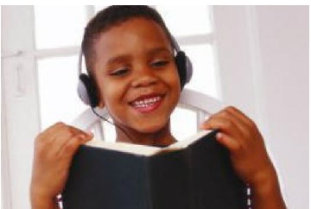
Accessible Formats
Notes:
Now we're going to talk about specific accessible formats. These formats are all included in the resource guide that we've mentioned a few times, and I'll be discussing them in the order that are listed in that guide.

Slide 11
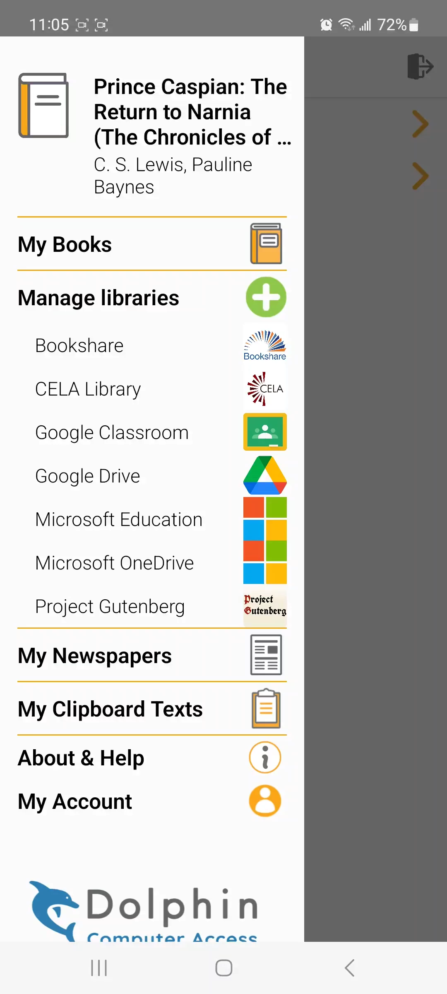
E-books
What: Book text represented on a screen
Why:
Customizable: font, sizing, and colour
Read along options
Voice controls
Who: Readers who are neurodivergent or have low vision, learning disabilities, dyslexia, or mobility disabilities
Notes:
EasyReader demo.mp4
First up are e-books. This is the format that people are probably most familiar with but might also be unaware of everything you can do with an ebook. And why it can be more accessible than a print book.
So first off, “ebook” refers to any book represented by text and/or pictures in a digital format. You can read them on e-readers, computers, tablets, and smart phones. And the great thing about ebooks is that they are really customizable! This makes them accessible to readers with a wide range of disabilities.
Most reading apps, like OverDive’s Libby or the Dolphin Easy reader app, which I’ll demonstrate in a moment, allow you to modify the text settings. You can change the type of font, the size of the text, the margins, the line spacing and sometimes even the spacing between letters. You can also adjust the colour of the text and the background. All of this can be helpful for readers with low vision who may need large print or a specific type of colour contrast. It’s also really helpful for neurodivergent and dyslexic readers. Changing the sizing can mean fewer words and more white space on the page, which is less visually overwhelming and is helpful for readers whose eyes tend to jump around the page a lot.
Many struggling readers also benefit from hearing an audio version while they are reading the print text. This can help readers more effectively process the text and improve pronunciation. Some ebook formats, such as DAISY text books offer a read along version which highlights the text as it reads it aloud. I’m going to show a quick video of this now using the Dolphin Easy Reader app, which is a great, free resource for struggling readers.
Lastly, before I move on, I want to add that both Libby and Easy Reader are compatible with screen reader technology used by folks who are blind or have certain reading disabilities. And they’re also compatible with both voice controls and adaptive switch controls, allowing people with certain mobility disabilities to navigate the apps and read independently.
DAISY text ebooks can be downloaded from CELA’s website. The more commonly known EPUB files and Word documents are also often available.

Slide 12
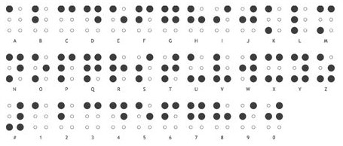
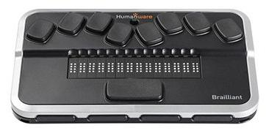
Braille
What: A series of raised dots. Each letter or number is made of a combination of six dots.
Why:
Read by touch not sight
Important literacy tool
Can read independently and at own pace
Available in print and electronically
Who: Readers who blind, deafblind, or have low vision
Notes:
Next up is braille. This format is a series of raised dots that allow the reader to read by touch rather than sight. Braille is mostly used by readers who are blind, deafblind, or have low vision. Each letter or number is made of a combination of up to six dots, called a braille cell. The image on the top right of the screen is the English braille alphabet.
There is the misconception that braille use is being completely replaced by forms of audio technology, such as screen readers and speech-to-text. While these are important tools, braille is too. Learning braille is important for developing literacy skills, such as letter recognition, composition, phonics and grammar, and numeracy. It fosters independence and allows the reader to read at their own pace.
Braille is available in two formats: the print version that most people are familiar with, which is embossed dots on physical paper. Electronic braille is a digital format that allows readers to read text from a screen using something called a braille display. There is an example image of a braille display on the slide. This device has moveable little pins that raise up and down to form braille, displaying one line of text at a time and then changing as the reader navigates throughout the screen. Here’s quick video to give you an idea of how a braille display works.
PLAY VIDEO: https://www.youtube.com/watch?v=IIQNhFpbbEI
Lastly, I want to mention printbraille books. These are picture books that have had see-through braille sheets added between the pages. Because they tend to be simple text, they are great for beginning braille readers. They also allow sighted and blind readers to read together—so two children can read together, a blind parent can read to a sighted child, or a sighted parent can read to a blind child.
You can order physical braille and printbraille books from CELA or download electronic braille directly from our website.

Slide 13
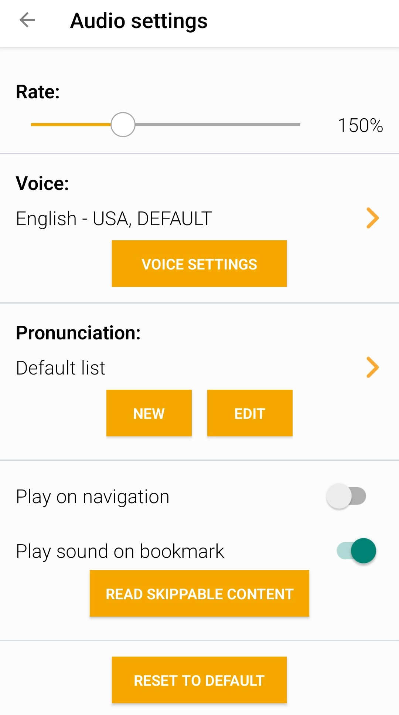
Audiobooks
What: Audio narration off text and image descriptions.
Why:
Customizable: speed, replay, voices
Critical listening skills, pronunciation, vocabulary
Stay current with school material and popular books
Who: Readers who are neurodivergent or have low vision, learning disabilities, dyslexia, or mobility disabilities
Notes:
Let’s talk about audiobooks. Using this format is sometimes called “ear reading.” They use synthetic or human narration to read out the text of a book. Many will also incorporate descriptions of any illustrations. And increasingly, audiobooks, especially adaptations of graphic novels, use multiple voice actors and incorporate sound effects and ambient noise for a truly immersive listening experience.
Like ebooks, they are customizable, allowing the reader to change the narration speed, replay sections, add bookmarks, and navigate throughout the book. Sometimes you can even choose an entirely different voice. The image on the right side of the screen is the audio settings in the Dolphin EasyReader app, which lists these different customization features.
Audiobooks are an important accessibility tool for readers who are blind or have low vision, but they are also essential for some readers who are neurodivergent, or have certain learning disabilities, dyslexia, or mobility disabilities that make turning pages or focusing on a book difficult. And they help improve critical listening skills, as well as vocabulary and pronunciation.
For many students who read at a lower level than their age peers, having access to audiobooks means that they can stay current with their school material and the popular books that their friends are reading. They ear read those books and then use simpler books to develop their print reading skills. This way they can still work on improving literacy skills but don’t have to struggle through their history or science homework.
Both human and synthetic narrated audiobooks are available as downloads and CD from CELA.

Slide 14
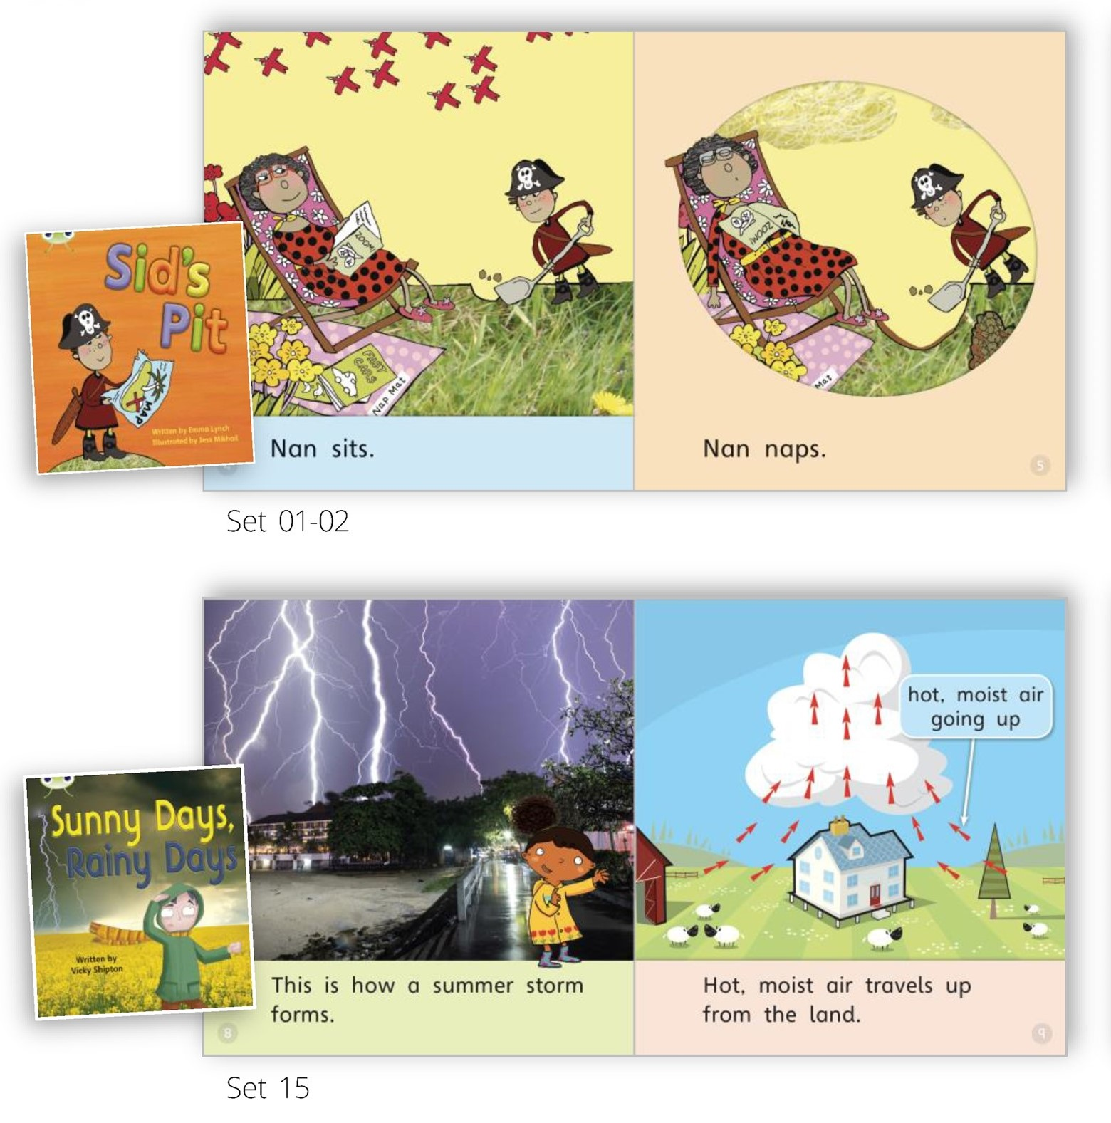
Decodable books
What: Beginning reader books designed using phonics principles
Why:
Use words that can be sounded out
Build on skills in previous levels
Develop confidence
Who: Readers who are neurodivergent or have learning disabilities or dyslexia
Pearson's Bug Club Phonics Decodable Readers
Notes:
Speaking of using simpler books to develop print reading skills, next up are decodable books. These are beginning reader books but are often more accessible than mainstream leveled books, especially for readers with dyslexia.
Decodable books are designed using the principles of phonics, which is the way we teach how sounds are associated with individual letters and combinations of letters. Decodable books specifically use words that can be sounded out, rather than encouraging readers to guess at words based on the images or context. Like other leveled books, they do get progressively more difficult but instead of using words that are arbitrarily more complex, they intentionally build on the skills developed in the previous books. This not only helps readers develop their print reading skills but also confidence in their reading ability. They are purposefully simple books, and a new book is typically only introduced after the reader can comfortably read the previous book independently. The image on the right of the screen shows examples of two decodable books from the publisher Pearson. The top image is from the first set of books in the series, with only two words per sentence and lots of repitition. The bottom image is from the 15th set of books in ther series, with longer sentences and more complex words.

Slide 15
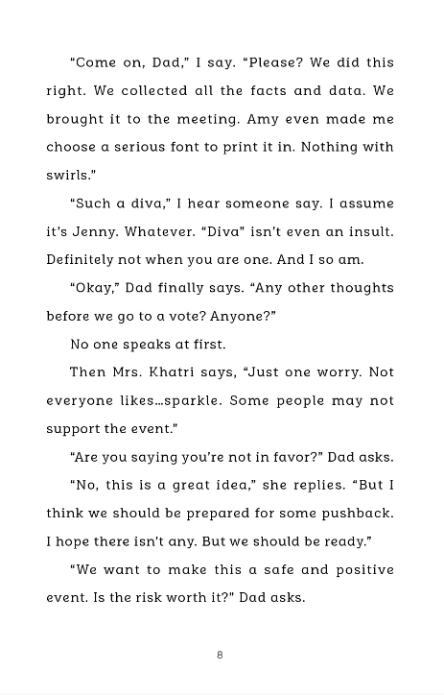
Hi-Lo books
What: Books with a high interest, age-appropriate story but a lower reading difficulty level.
Why:
Fast-spaced stories, complex characters, relevant subject matter
Simple vocabulary that builds decoding skills
Shorter sentences, paragraphs, chapters, and overall length
Who: Readers who are neurodivergent or have learning disabilities or dyslexia.
Example hi-lo book from Orca Book Publishers.
Notes:
What happens when a reader develops print reading skills beyond those in a decodable book, but maybe isn’t ready for the same reading level as many of their age peers? This is where hi-lo books come in. These are great for school-age kids and teens, as well as adults who want to read books with content that is age-appropriate and interesting, but at a lower reading level. The term hi-lo means high interest, low reading level.
Hi-lo books feature fast-paced stories, often with lots of action and dialogue rather than descriptions, plus complex characters and subject matter that is interesting and relevant. They are designed to capture your interest and keep it.
Like decodable books, hi-lo books specifically use simpler vocabulary that helps build decoding skills. They are also designed to not be overwhelming. Their overall length is shorter than the average novel, but they also use shorter sentences, which allow the reader to process one concise thought at a time. And they have shorter paragraphs and chapters, which provide built-in places for a reader to take a break and a sense of accomplishment. The image on the right of the screen shows an example of these features. This is a page from a book published by Orca, which is a great source of hi-lo material.
The intention of a well-written hi-lo book is to give the reader an enjoyable reading experience at their skill level without feeling like they are reading books for little children.

Slide 16
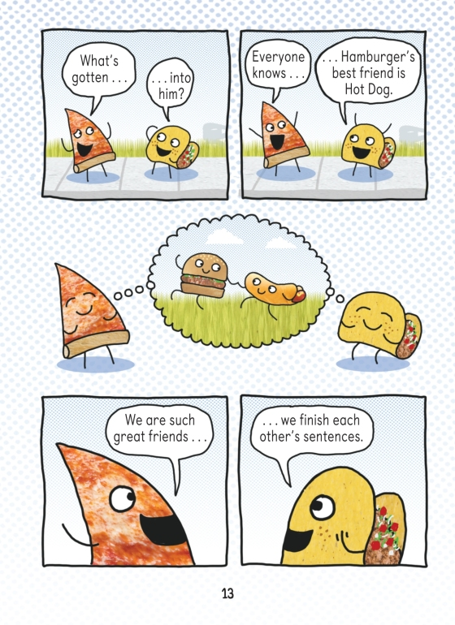
Graphic novels
What: Books using both text and illustration, usually formatted in comic strip-style panels.
Why:
Not lazy reading!
Short segments of text
Improve visual literacy
Who: Readers who are neurodivergent or have learning disabilities or dyslexia.
Pizza and Taco: Who's the Best? Written by Stephen Shaskan, 2020.
Notes:
Last up is graphic novels. This format often isn’t included in discussions of accessible literacy, but it should be! Graphic novels have a lot to offer and can be an important literacy tool for some readers.
First thing is that graphic novels can be just as high quality as text-only novels. They are often dismissed as “lazy reading”, but they can have complex plots, compelling characters, and often introduce readers to new vocabulary.
But unlike regular novels, they combine text and illustrations. This means that the text is generally in shorter segments, rather than long paragraphs. And it’s usually dialogue, sound effects, or just a very brief description, rather than lengthy descriptions of the setting or scenery, for example. This can be helpful for readers who find larger blocks of text overwhelming.
Graphic novels can also help readers improve their visual literacy, which refers to the ability to interpret and understand images. A big part of the reading experience is reading the illustrations. For example, interpreting body language and facial expressions, or following the action sequences. Readers can also use the visuals to provide context to help them better understand the text. On the right side of the screen is an example of a graphic novel that has particularly good accessibility features. This is from the Pizza and Taco series by Stephen Shaskan. It has short sentences and the illustrations are simple but effective. The text is also types, rather than handwritten, which means that the shape and sizing of the text stays consistent.
It is important to note that, like all formats, graphic novels are not universally accessible. They can be particularly difficult for readers who are blind or have low vision, but also for readers who are easily distracted or overwhelmed by visual stimulation. Fortunately, more and more graphic novels are now being adapted into audio versions, making them accessible to a wider audience.

Slide 17
Reading is more than novels
Recipes
Narratives and dialogue in video games
Poetry and song lyrics
Closed captions on TV
Instructions for board games, activities, experiments, etc.
Maps and travel directions
Joke books
Notes:
In addition to reading in many different formats, there are other ways to practice reading, even if it’s not reading a whole novel or longer paragraphs. Someone who is a reluctant or struggling reader will be more tempted to read if the content is of interest to them. In fact, they may be reading more than you think if you consider all the text that’s part of our daily lives. This could include reading subtitles or captions on our phones, narratives in video games or simply reading instructions, signs and travel directions. It can be helpful to have books with shorter texts like poetry, joke books or even cookbooks around so there are a variety of materials at hand.
Question: Can you name other types of reading sources?

Slide 18
Design and layout matter
Look for books that have:
Clear fonts that aren’t too small
Clear images and text and not “busy”
Novels with:
  wider margins and line spacing
  left-aligned text
  shorter sentences and whitespace
Notes:
If you’re looking for reading materials for someone, you may wish to consider some design and layout elements that can make the reading experience easier. In general, you want books written in a clear font style that’s not too curvy or too small. It also helps if the images and text are not overlapped in a way that obscures the words, nor the pictures in the book.
When it comes to choosing novels or short stories, it can be easiest to read books with wider margins and slightly wider spaces between the lines. When text is too cluttered, it can be difficult to distinguish where the next line begins, and the appearance of a mass of text may dissuade struggling readers from trying to read the book. For low vision users, especially those using screen-magnification software, it’s helpful to have the text left-aligned. On a last note, finding books with shorter sentence structure and lots of white space can be more appealing and easier to read.

Slide 19
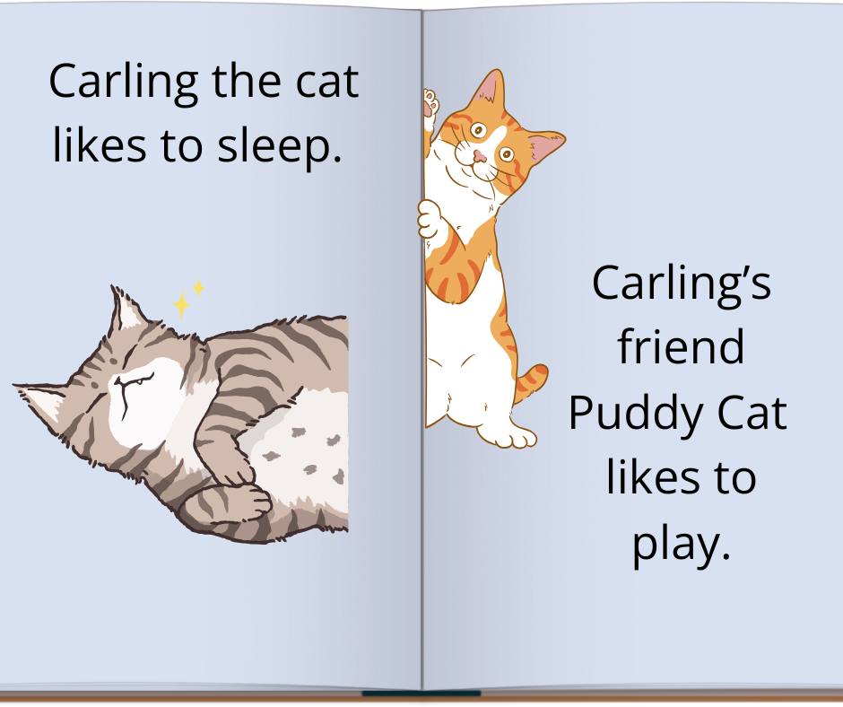
Clear layout
Sans-serif font
Larger font
Ample white space around text
Contrasting text and background colours
Notes:
Here is an example of a well laid out picture book. It uses a san- serif font and the text size is large enough to read clearly. There is also ample white space around the text and the images. The background colour has enough contrast in relation to the text and image colours so all the components on the page are distinguishable.

Slide 20
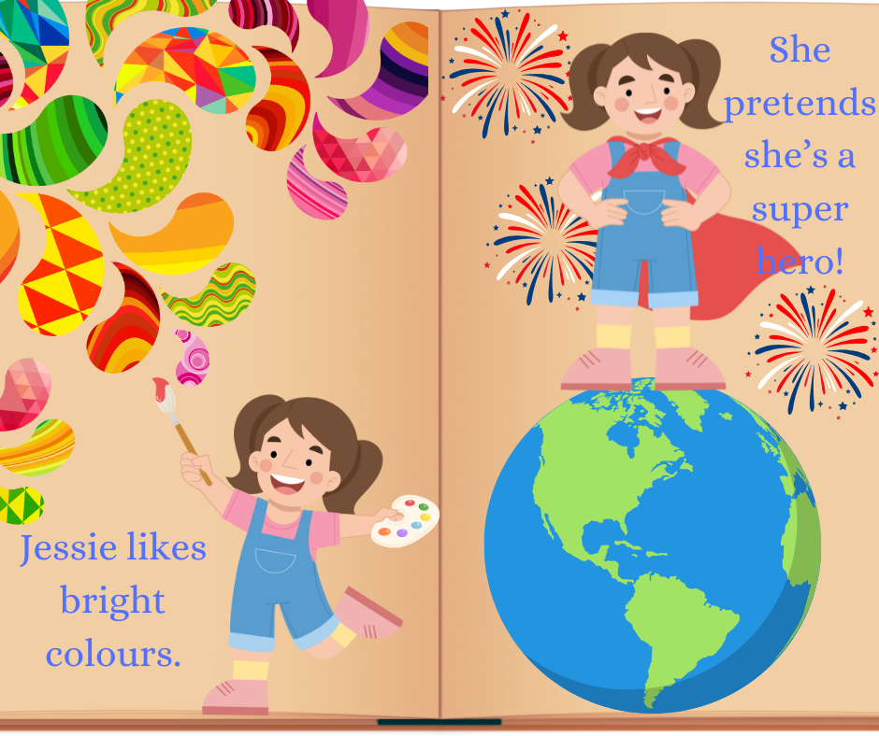
Busy layout
Cluttered images
Smaller font
Difficult to focus
Poor contrasting text and background colours
Notes:
In contrast, the pages in this book are cluttered. It features small text that is in a colour that's not in contrast with the background. The images are also very busy so it might make it difficult for the reader to focus on the text and images relating to the story.

Slide 21
How you can help!
Ask readers how as well as what they’d like to read
Offer choice: genre, content, style
Equalize alternate formats and print by displaying both
Spread the word! Encourage others to adopt a multi-format reading approach
Notes:
We've covered a lot of information in our presentation today and we really hope that you leave understanding the benefits and advantages of using accessible reading formats for different readers. We’d like to support you by giving you some tips to use with the readers in your lives. As a start, it’s helpful to ask how as well as what someone would like to read. This drives the message that reading is acceptable in any format. To try and encourage and inspire reading, offer a choice of different genres, different types of content or topics and different writing styles. Next if you are a librarian or work in a school library you can help equalize all reading formats by including both print and non print formats in displays or when you're talking about books. And lastly, we hope you're going to spread the word about the importance of using different reading formats and that they are helpful to reading success and enjoyment.

Slide 22
Thank you!
Rachel Breau, Manager Member Services rachel.breau@celalibrary.ca
Denise Scott, Program Assistant
denise.scott@celalibrary.ca
Accessible literacy resource guide
celalibrary.ca 1-855-655-2273 ext. 2
Child and Teen Library Accessibility Interest Group!
Educator Access Group

